Slide 1

GE Predix
Microservices & APIs

Slide 2
Solution Context
Opportunities
Substantial opportunities exist for GE to create and market secure, reliable, standards-based Application Programming Interfaces (APIs) that will…
Enable GE to:
Generate new revenue streams
Market individual capabilities and packages of capabilities as subscriptions
Gain deep visibility in demand and usage of individual features and functionality through usage metering
Accurately invoice customers, users, and developers based on their actual usage of features and functionality
Enable GE’s customers, Predix users, and application developers to:
Integrate securely though standards-based Web interfaces
Incorporate functionality into applications and IT solutions
Create new and innovative solutions & applications built on capabilities and functionality available in Predix
Automate human interactions to reduce costs and exposure to operational risks
Automate reactions to events, trends and alarms in order to shorten reaction times and prevent service disruption & outages
Additional opportunities for reporting enhancements :
Ability to deliver reports to external systems through standard integration mechanisms (ex: HTTP/S POST)

Slide 3
Solution Context
Solution Context
Goals/Objectives
Modernize functionality in InSight by transforming existing functionality to cloud-native, hyper-scalable microservices with secure, scalable APIs that provide GE’s customers, users, and Predix developers standards-compliant programmatic access to capabilities and functionality through RESTful APIs
Initial focus area: Reporting
Enhance reporting to support the following additional use cases:
Delivery of reports to external systems through standards-compliant Web-based integrations: event notifications/web hooks, HTTPS posts, etc.
Anticipated Outcomes
Reporting functionality is elastically scalable, leveraging cloud based infrastructure to automatically scale up/down as required, promoting infrastructure efficiency and reducing exposure to operational risks such as performance problems, scalability challenges, and service reliability

Slide 4
Current Challenges
Insight Limitations
Closed system
3rd parties can't develop on it
Unable to handle multi-site & multi-platform data
Limited to internal data ingestion only

Slide 5

Features Landscape InSight vs. Predix Reporting
Features | InSight | Predix
Reports Builder
Scheduling
Report Management
Data Visualization
Alerts/Alarms Capability
Eventing/Trending Capability
Report Distribution
Multi-tenancy
Data Federation
Multiple Asset Models
Multi-plant Reporting
API Management

Slide 6
Predix Onboarding
Predix platform evaluated
Predix Components Used
ReportsLab
Sample App
Asset Model Setup
Times Series Setup
Job Scheduler
Metadata using Postgres SQL
UI
Predix Line Charts
Data Systems
Predix Time Series
Predix Asset
Grunt
Node
Predix PostgreSQL
Billing/Metering
ReportsLab
API Framework
Python
APM
Predix UAA/ACS
Cloud Foundry
Other Services
Predix Bar Chart
Predix Data table

Slide 7
Risk and Challenges
Risk & Challenges
Predix environment lacks maturity and stability
Outdated components, such as, Nurego in Predix
SSO Integration
No individual element level permissions setup
Lacks Asset Model data structure optimization
No automatic software and configuration packaging tools
Governance Model is not fully understood to make this capability available for external consumption

Slide 8
Overall Project Plan

Slide 9
Milestone
Sprint 1
Sprint 2
Sprint 3
Sprint 4
Completed
Planned
Goals
Line Chart
Bar Chart
Blue prints List
Report List
Canvas
Reporting UI
Pie chart
Vertical Bar chart
Basic Data Table
Report Generation
Report Management
Goals
Advanced Chart Features
CP chart, Image Services, Base text Editor
Loading Blue prints
Maintain Report History
Preview PDF
Scheduler Functionality
Data Abstraction Layer
Raw Data Report
Reports Generation Queuing System
Repots Generation Workers, Reports Emailer
Administration UI ,Configure TS/AM

Slide 10
Benefits
Shifting Power to End Users
Data Federation to accommodate multi-site and multi-platform data
Blazing the trails …
Enhancing Predix platform maturity
Multiple asset model capability
Reporting solution portable to Predix or any other cloud platform

Slide 11
Why UST?
Intimate Insight Knowledge - we wrote it
Expertise in Predix - Predix team borrowed ideas from Insight to build a lot Predix features
UST's experience in Microservices and Predix
Microservices
T-Mobile
EMC
Anthem
MacQuarie bank, Australia
Predix
Currently working closely with the Predix Architecture team
Identify issues, recommend solutions
Help mature platform
Evangelize platform
Insight on Predix
UST has started porting Insight capabilities, e.g., reporting on to Predix
API management expertise
Best value for your investment

Slide 12


Slide 13
Appendices
Appendices

Slide 14
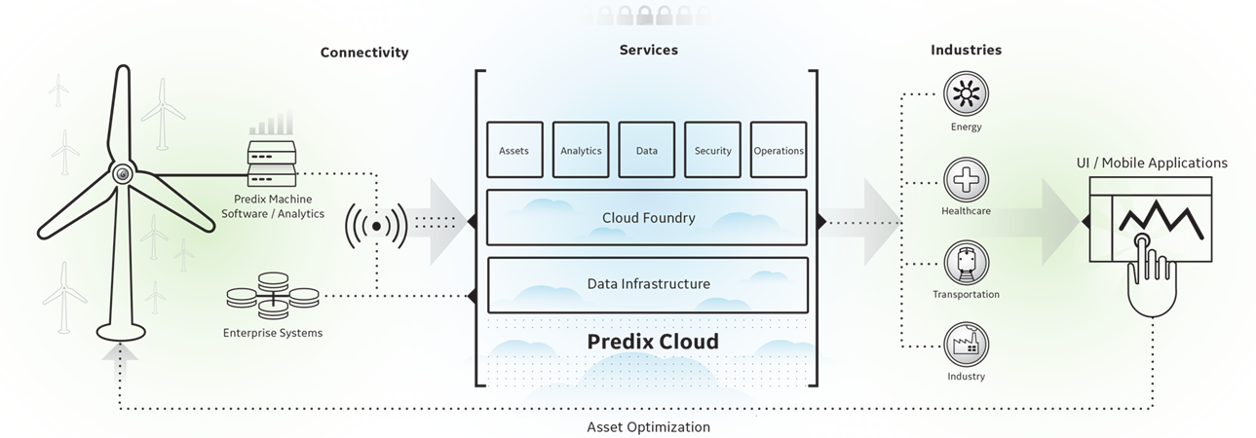
Predix Cloud Platform
Platform for future of all GE applications and services
Built on Pivotal Cloud Foundry PaaS
Microservices-based architecture
Pre-built templates & accelerators
UI components for Web & Mobile
Rich services ecosystem
Data Management Services
Asset Data - create and store machine asset models
Time Series - Manage, ingest, store and analyze data
SQL Database - PostgreSQL
Key-Value Store - redis - key-value cache and store
AMQP - RabbitMQ - messages between apps, components and devices
Blobstore - Binary large object storage
Security Services
User Account & Authentication
Access Control Service - Robust access control
Tenant Management - instance provisioning for tenants and runtime access
Analytics Services
Analytics Catalog
Analytics Runtime - elastic execution
Analytic User Interface - to upload, validate, and run analytics
GeoEnhance - pitney bowes - for location services
Edge Software & Services
Machine - enables machine to machine, machine to cloud, and machine to human connectivity
Edge Manager - Deployment and Monitoring
Connectivity - plug-n-play, secure, and reliable connectivity services
Commercialization Services
Business Operations - nurego - to monetize services using subscription mgmt., profitability analysis, and customer segmentation
App Services
Views - Control layout and component for UI
Workflow - azuqua - for workflows between apps
Resources – App Dev Tools
DevBox - Predix-ready bundle of preinstalled and preconfigured app development tools
Buildpack - Cloud Foundry - Cloud Foundry compatible buildpacks
Machine Data Simulator - generate time series test data series, Machine, Analytics and Visualization
DevOps Services
Logging - Logstash - log, save, search, and visualize logs
Mobile Services
Mobile SDK - quickly build mobile apps to monitor, service, and maintain assets
Mobile Service - design, develop, and deploy mobile apps

Slide 15
Contents
Solution Context
Problem Statement
Microservices Transformation Process
InSight Opportunity Landscape
Reporting User Stories
Feature Landscape Reporting vs. Predix
Predix & InSight
Overall Project Plan
Milestone
Risk and Challenges

Slide 16
Problem Statement
Insight Closed System
Can't develop on it for 3rd parties
Lacking Ability to
Report on data outside Insight
Multi-site & multi-platform
Regulatory reporting
External outside data ingestion
Predix
Can't Visualize it

Slide 17
Microservices Transformation Process
InSight
Microservices Platform
Extract “vertical slice” of application functionality
1
Platform Security
2
UI
Package as Microservice(s)
API Security
API Layer
Microservice 1
Microservice 2
Microservice n
UI
UI
UI
Expose functionality through APIs
Application Services Layer
APII
API
API
4
Logic
Logic
Logic
Data
Data
Data
3
Deploy on Microservices Platform
Microservice 1
Microservice 2
Microservice n
Middle Tier Application
Code
$
…
Usage Metering
Billing & Chargeback
Data Services
Platform Services
Backend Dependencies
Backend Dependencies
Infrastructure

Slide 18
InSight Opportunity Landscape
Security APIs
Account APIs
Sites & Controllers APIs
Trends API
Reports APIs
Rationale
Fast time to value
Low Risk of undesirable “ripple effects” of changes due to high cohesion and loose coupling in reporting today
Opportunities to gain scalability improvements at same time
Report metadata currently stored in Oracle; migrating to scalable database will support larger customer base
Generated reports are currently stored in network file storage; S3-like BLOB storage preferred for achieving true Web scale
Activity APIs
User Mgmt
Account Mgmt
Value Projects
Alarms
Sites
Trends
Reports Definition
Analytics APIs
Role Mgmt
Fleet Mgmt
File
Mgmt
Comments
Controllers
Reports Generation
Assets APIs
Analytics
Data APIs
Reports Management
Inventory Mgmt
Annotations
Assets
Time Series Data
Reports Distribution
Missed Updates
Parameters
Initial Focus Area

Slide 19
Reporting User Stories
As a user,
I want to be able to automatically upload reports into my Web-connected system(s)
So that my GE InSight reports are automatically available in the systems I need them to be
Whereas today, delivery to my systems over HTTPS POST is not supported
As a user,
I want to be able to author, generate, view and schedule reports on my Predix time series and asset data
So that I can understand and visualize my Predix data
Whereas today, robust reporting functionality is not available in Predix.
As a Predix application developer,
I want a set of easy-to-consume, well-crafted, well-documented, secure & scalable APIs that expose reporting functionality
So that I can build new and innovative applications and features that incorporate the powerful reporting capabilities,
Whereas today, these capabilities are not available in Predix.

Slide 20
Risk and Challenges
Risk & Challenges
Governance Model is not fully understood to make this capability available for external consumption
How soon insight can be there in My Plan
How far we are away from insight to reporting
Outdated in Predix
How do we market
SSO Integration
Setting Permissions to individual elements
Build automatic scripts to later stage
Optimizing Data structure of Asset Model

Slide 21
Values and Advantages
Vision for InSight
- API Management
- Service Monetization
- Features, Features, ..
Unfair advantages
- Predix
- Methodology
- Experience
- Solutions
- Technology
Data Federation
Potential

